Slide 1



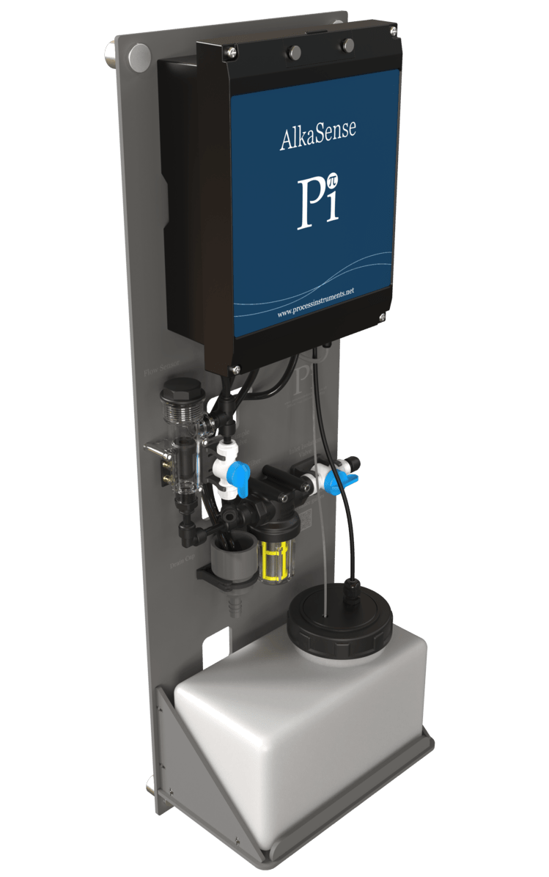
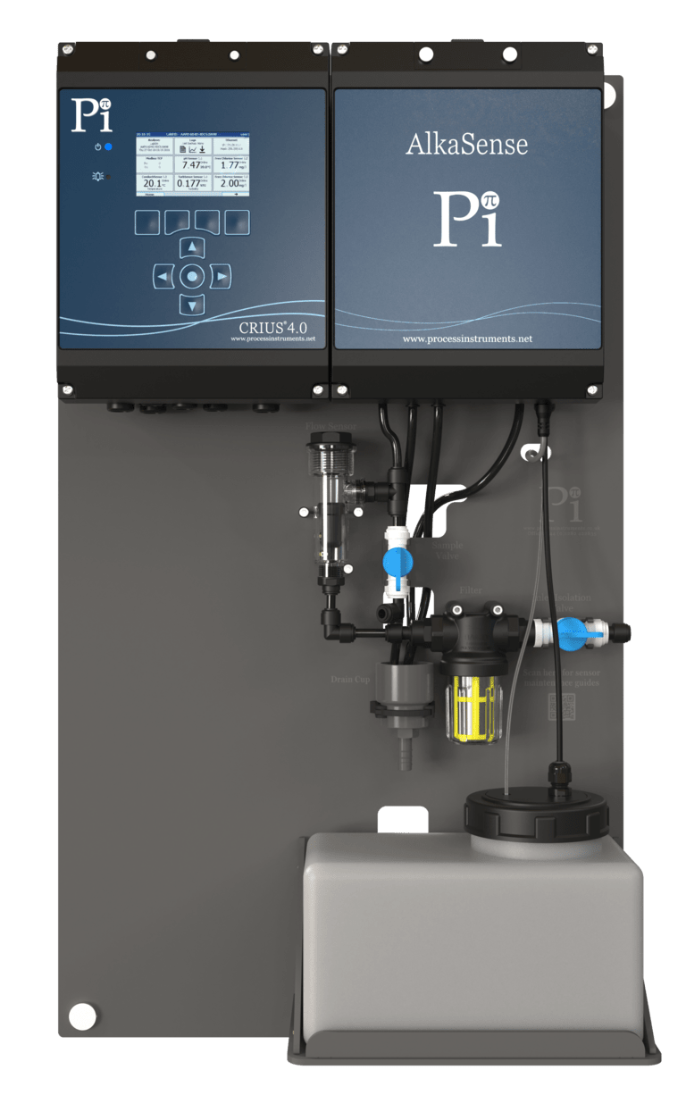
AlkaSense®
Total Alkalinity - AlkaSense®
Process Instruments (UK) Ltd.
www.processinstruments.co.uk

