Slide 1
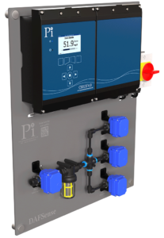
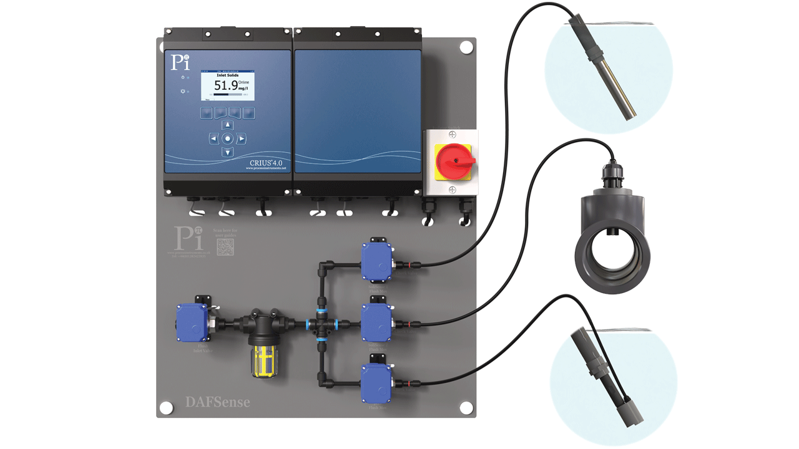
DAFSense
DAF Coagulation Controller & Dosing System - DAFSense
Process Instruments (UK) Ltd.
www.processinstruments.co.uk

